Slide 1


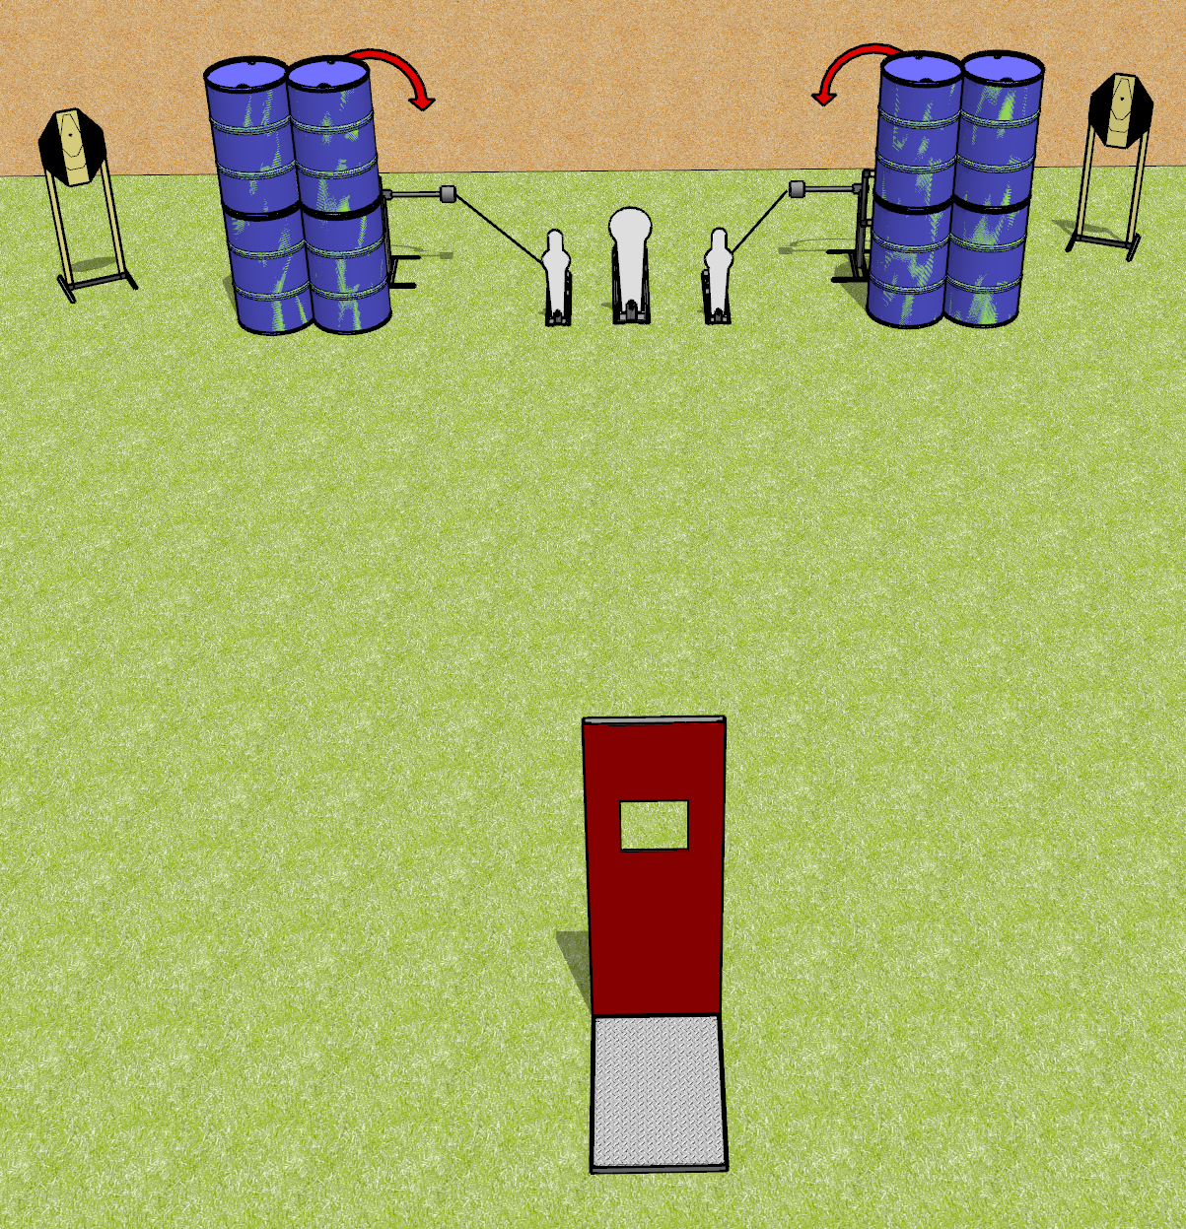
 | Dothan Gun Club – USPSA Match To the Sides Course Designer : Drew Coleman
Round Count 11 rounds 4 IPSC 2 MP, 1 colt popper
Equipment List 2 swingers + activators Barricade 2 tux

Slide 2
To the Sides
Written Stage Briefing
To the Sides is an 11 round, 55 point, Comstock course of fire. There are 4 IPSC targets and 3 steel. The best 2 hits on cardboard will score and steel must fall to score.
The swingers are activated by poppers and remain visible at rest.
Handgun start position is inside shooting area, hands touching upper marks. Handgun is loaded and holstered.
PCC start position is inside shooting area, muzzle touching either lower mark, stock on belt. Loaded carbine is held with both hands, safety on.
On the audible start signal, from within the shooting area, engage T1 and SW1, OR T2 and SW2, perform a mandatory reload, and engage the remaining array. Steel may be engaged at any time.

Slide 3
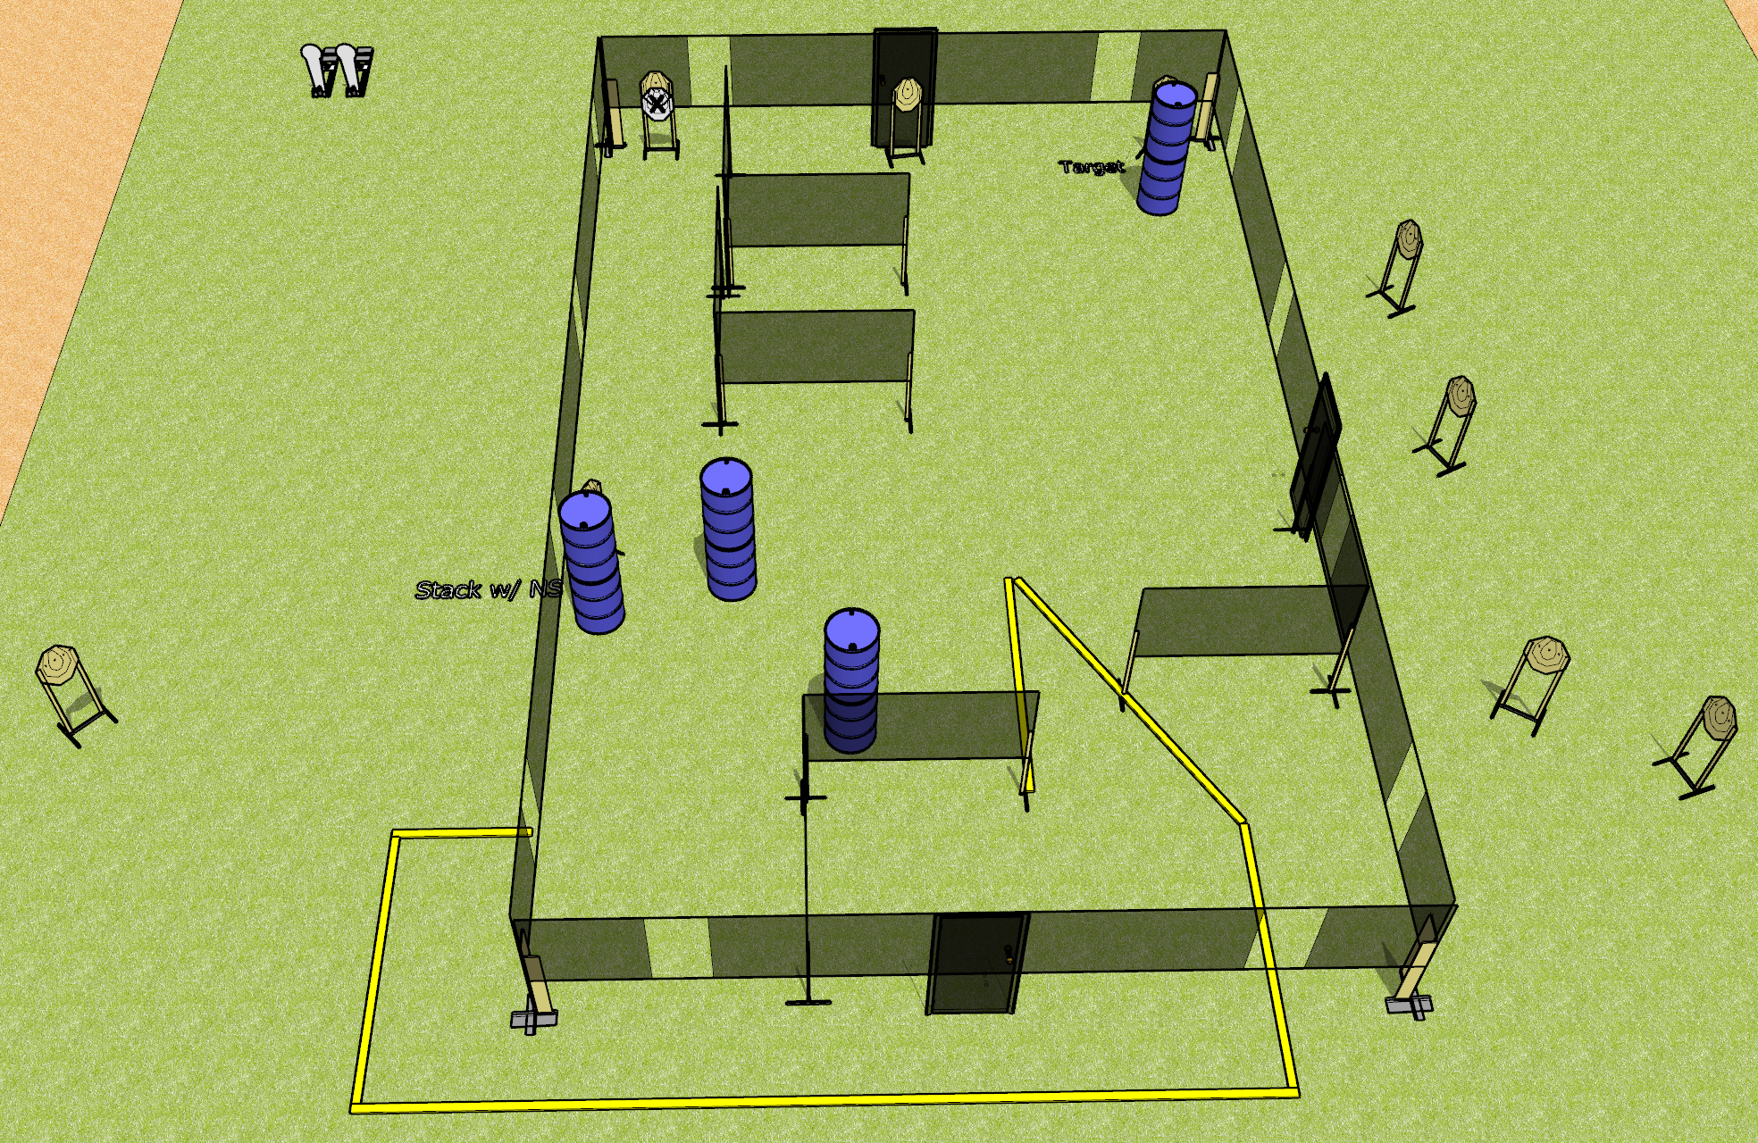
 | Dothan Gun Club – USPSA Match Chuggin Along Course Designer : Drew Coleman
Round Count 22 rounds 10 IPSC 2 colt poppers
Equipment List 1 medium fault line 12 targets (10 + 2 NS)

Slide 4
Chuggin Along
Written Stage Briefing
Chuggin Along is a 22 round, 110 point, Comstock course of fire. There are 10 IPSC targets and 2 steel. The best 2 hits on cardboard will score and steel must fall to score.
Handgun start position is feet on X’s, wrists below belt. Handgun is loaded and holstered.
PCC start position is feet on X’s, stock on belt. Loaded carbine is held with both hands, safety on.
On audible start signal, engage targets as they become available from within the shooting area.

Slide 5
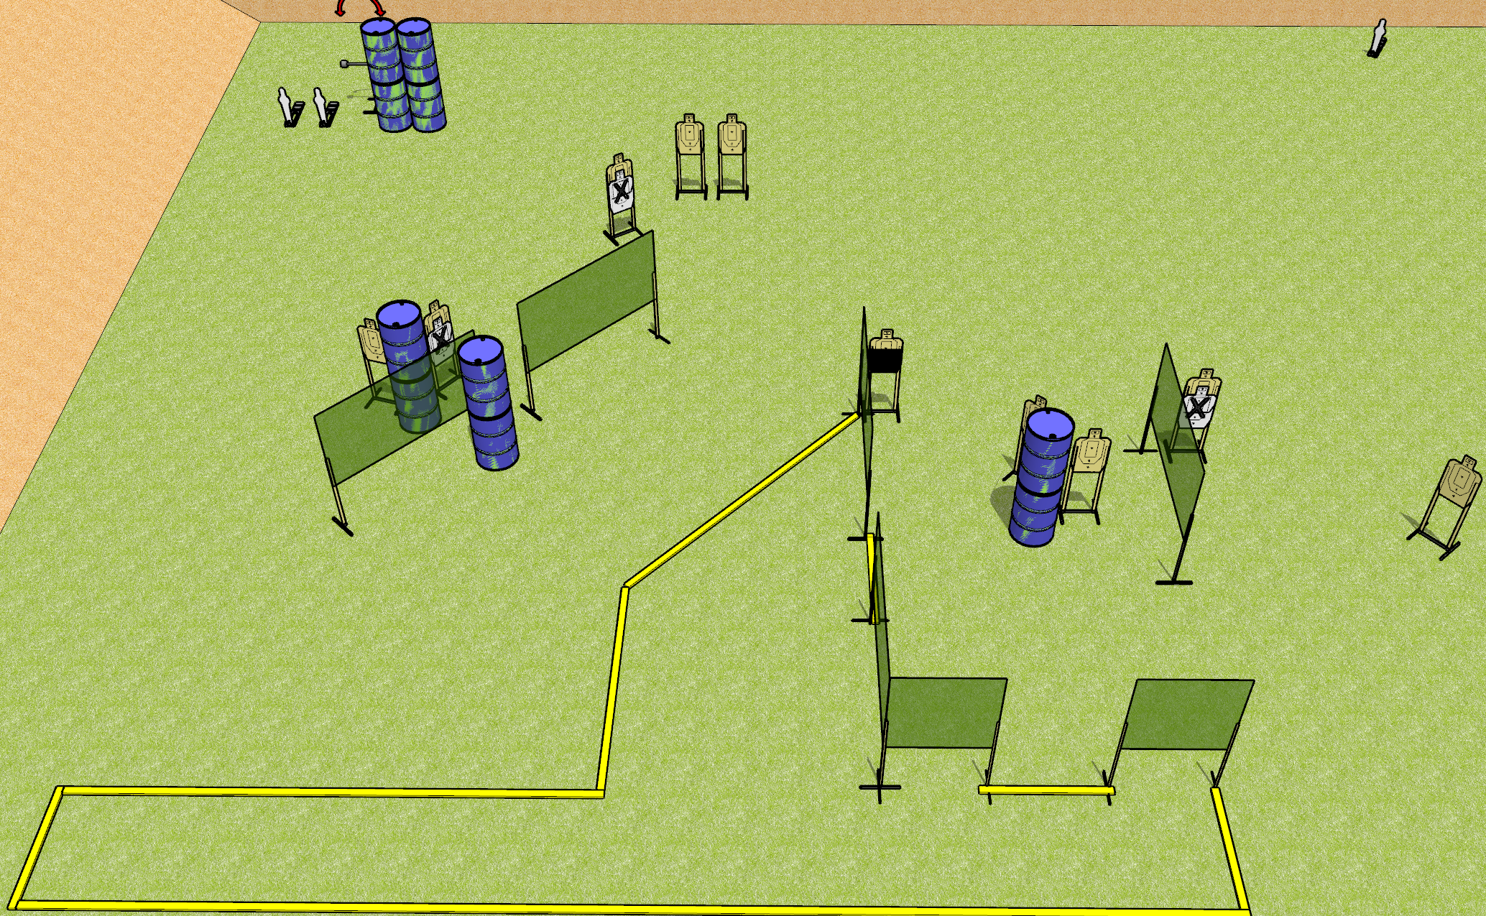
 | Dothan Gun Club – USPSA Match Jackknife Course Designer : Drew Coleman
Round Count 25 rounds 11 USPSA 3 MP
Equipment List 13 wall feet 4 medium fault lines Swinger + activator 1 50% 13 targets (10 + 3 NS)

Slide 6
Jackknife
Written Stage Briefing
Jackknife is a 25 round, 125 point, Comstock course of fire. There are 11 USPSA targets and 3 steel. The best 2 hits on cardboard will score and steel must fall to score.
The swinger is activated by mini poppers and remains visible at rest.
Handgun start position is anywhere inside the shooting area, wrists below belt. Handgun is loaded and holstered.
PCC start position is anywhere inside the shooting area, stock on belt. Loaded carbine is held with both hands, safety on.
On the audible start signal, engage targets as they become available from within the shooting area.

Slide 7
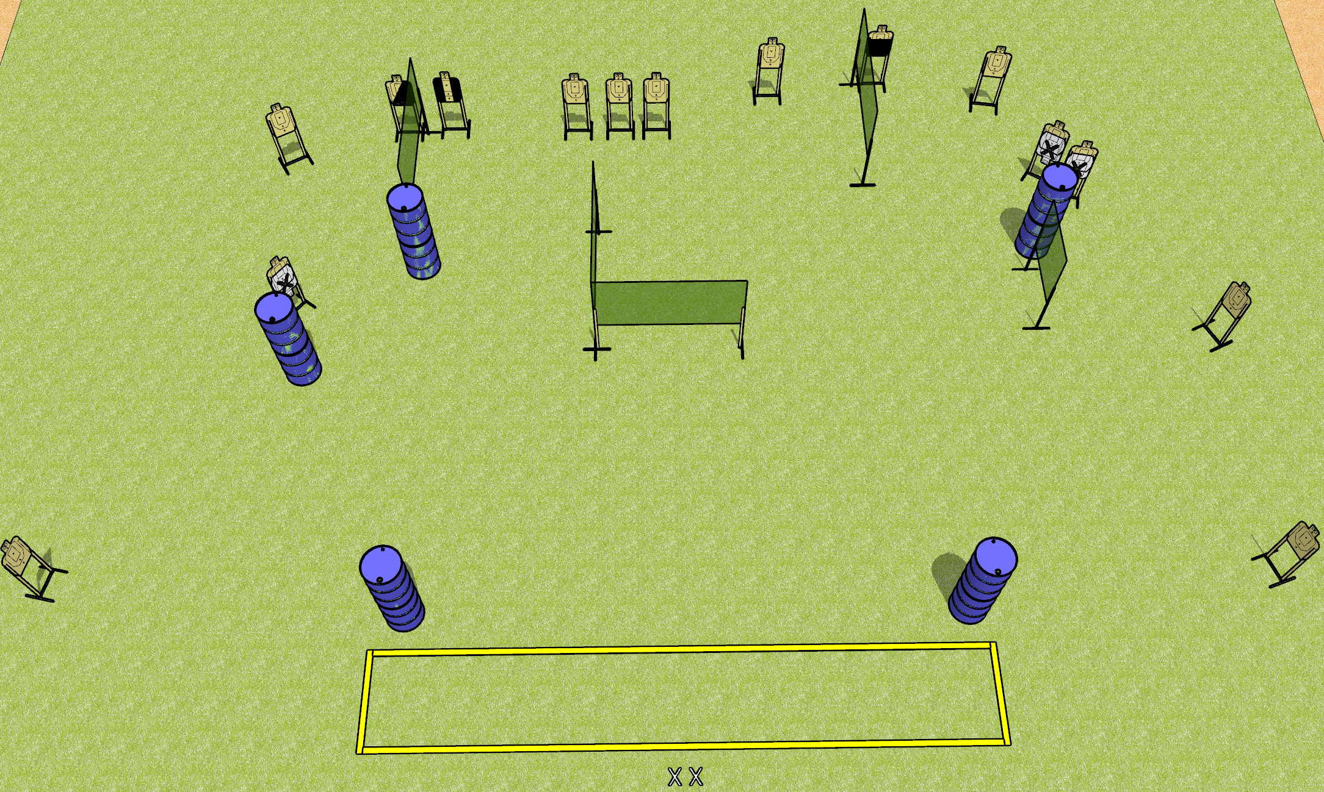
 | Dothan Gun Club – USPSA Match No Fun Course Designer : Drew Coleman
Round Count 30 rounds 15 USPSA
Equipment List 9 wall feet 2 medium fault lines 1 tux, 1 left diag, 1 50% 15 targets (12 targets, 3 NS)

Slide 8
No Fun
Written Stage Briefing
No Fun is a 30 round, 150 point, Comstock course of fire. There are 15 USPSA targets. The best 2 hits will score.
Handgun start position is feet on X’s, wrists below belt. Handgun is loaded and holstered.
PCC start position is feet on X’s, stock on belt. Loaded carbine is held with both hands, safety on.
On the audible start signal, engage targets as they become available from within the shooting area.

Slide 9
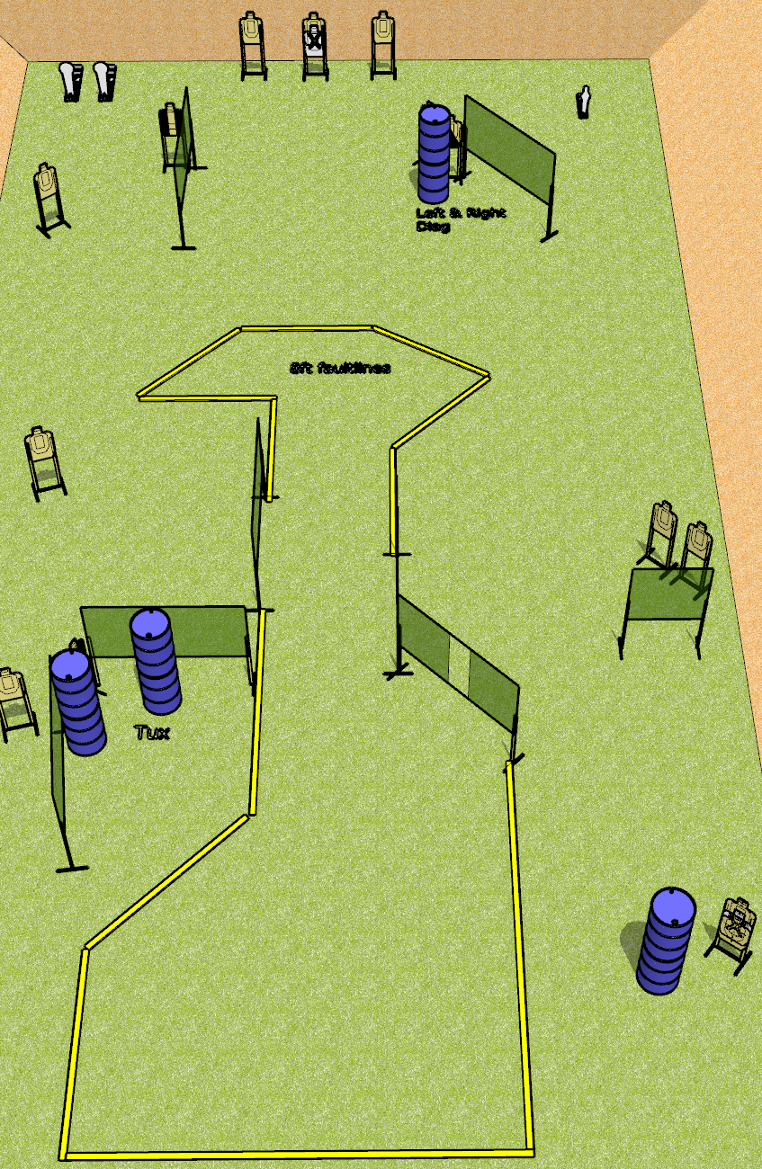
 | Dothan Gun Club – USPSA Match Long Run Course Designer : Drew Coleman
Round Count 31 rounds 14 USPSA 2 colt, 1 mini
Equipment List 14 wall feet 2 tux, 1 left diag, 1 right diag 12 paper (10 + 2 NS)
Stacked
w/ NS

Slide 10
Long Run
Written Stage Briefing
Long Run is a 31 round, 155 point, Comstock course of fire. There are 14 USPSA targets and 3 steel. The best 2 hits on cardboard will score, and steel must fall to score.
Handgun start position is anywhere inside the shooting area, wrists below belt. Handgun is loaded and holstered.
PCC start position is anywhere inside the shooting area, stock on belt. Loaded carbine is held with both hands, safety on.
On start signal, engage targets as they become available from within the shooting area.

